Slide 1
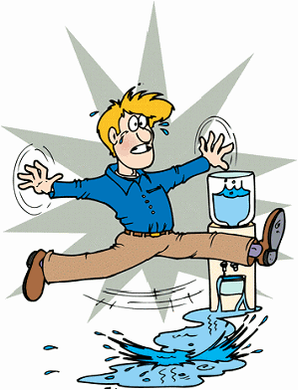
Be Mindful of these Causes of Injuries in Workshop
Bites
Vehicle – cars, golf carts, buses, etc
Burns
Needles/Scales – sticks, pricks
Electrical devise - shocks
Falling objects
CARE MUST BE TAKEN TO PREVENT INJURIES
THAT MEANS YOU!

